Slide 1

Week 6:
Convolution Neural Network
Machine Learning Using Tensorflow
Shu-Ting Pi, PhD
UC Davis

Slide 2
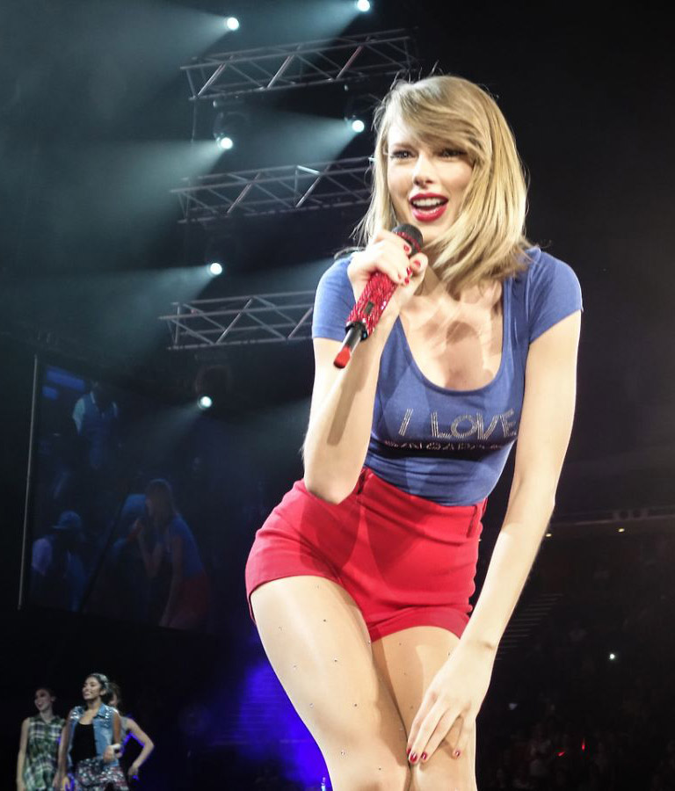
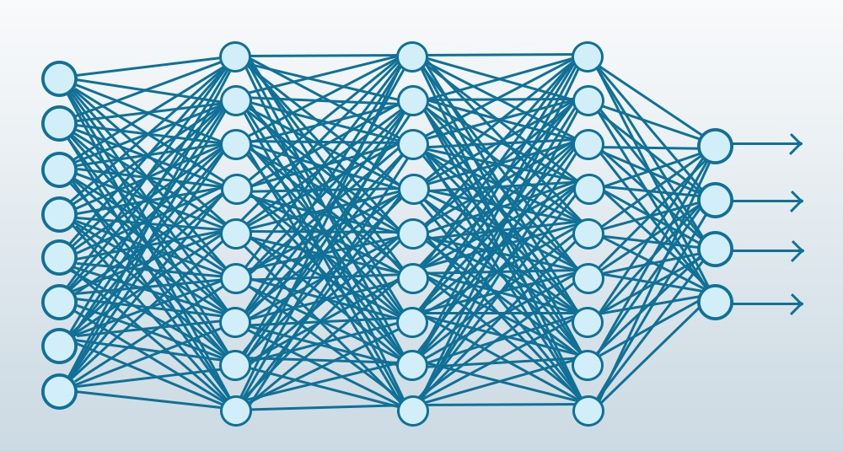
How many parameters?
256 x256 = 65,536 pixels
input
65,536
hidden1
x 32738
hidden2
x 16384
hidden3
x 8192
Output
x 10
Trainable Parameters ~ 3 x 10^18 ! Ridiculous !
Machine Learning using Tensorflow
Shu-Ting Pi

Slide 3
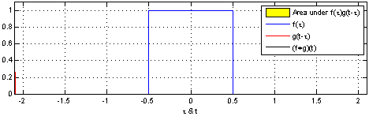


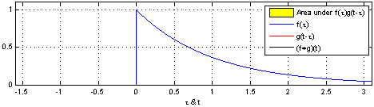
What is Convolution?
Weighted sum of a function !
Machine Learning using Tensorflow
Shu-Ting Pi

Slide 4
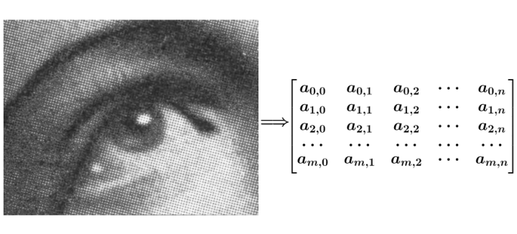
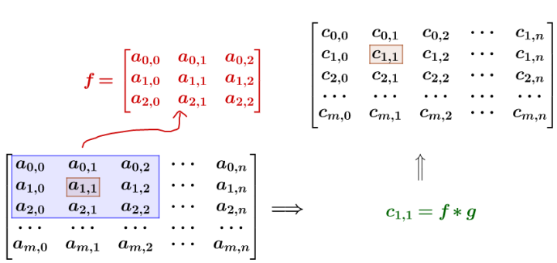
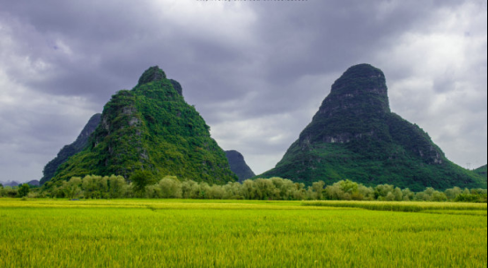
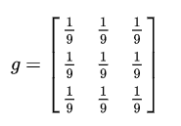
Use it to smooth an image
Machine Learning using Tensorflow
Shu-Ting Pi

Slide 5
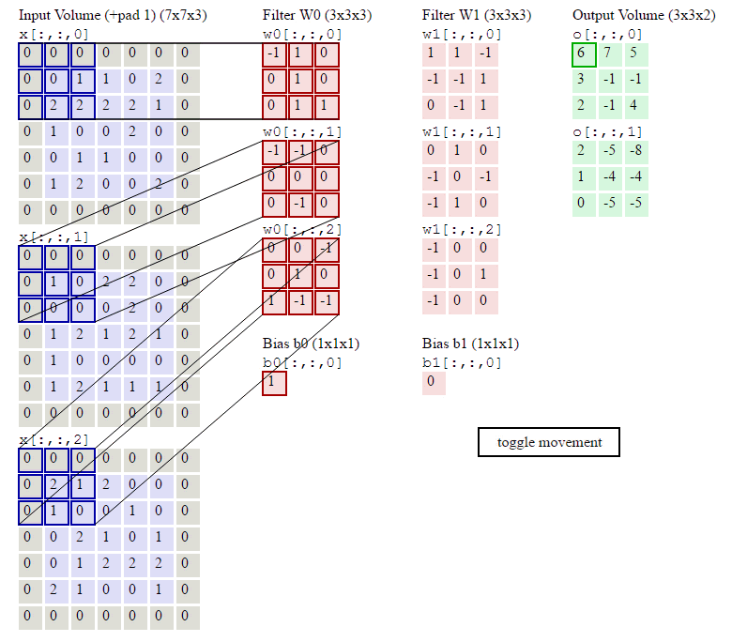
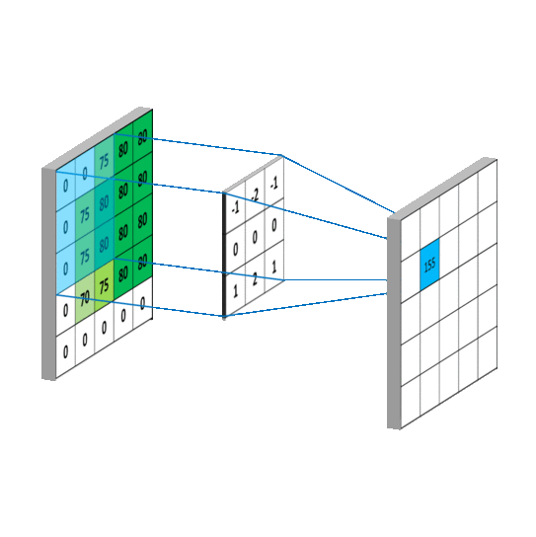
Continous Convolution
Machine Learning using Tensorflow
Shu-Ting Pi

Slide 6
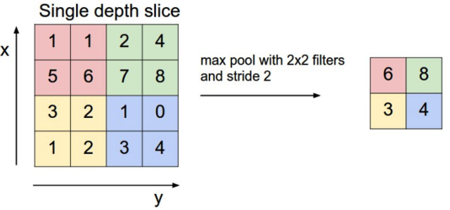
Max Pooling
Use the maximal value to represent the main feature of a block
Machine Learning using Tensorflow
Shu-Ting Pi

Slide 7
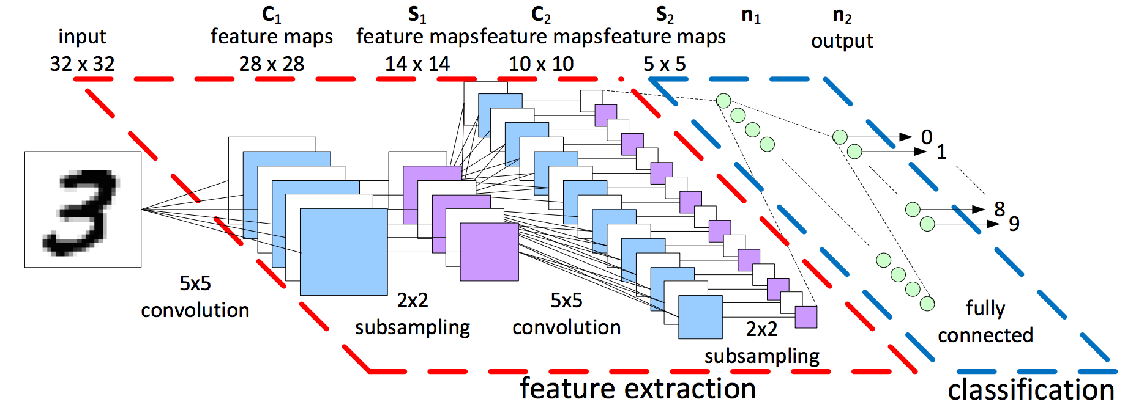
Procedure of CNN
Check this video released by Google:
  https://www.youtube.com/watch?v=jajksuQW4mc
32x32xn1
16x16xn1
16x16xn2
8x8xn2
32x32
All image block shares the same “filter lens”, parameters are highly reduced!
Image size: 32x32 → 8x8xn2 (width → deepth)
Machine Learning using Tensorflow
Shu-Ting Pi

Slide 8
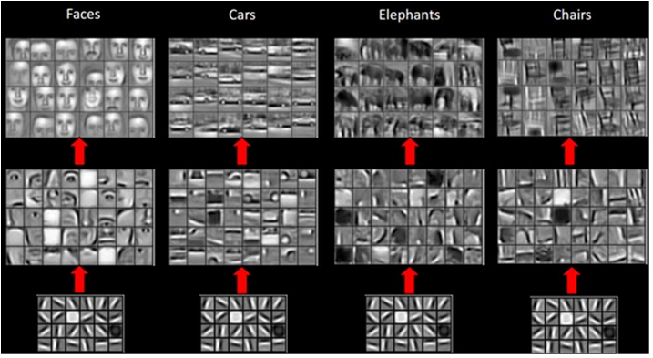
Why it works?
Image = local features merge to global feature !
(actually not only image but almost all kinds of information)
Machine Learning using Tensorflow
Shu-Ting Pi

Slide 9
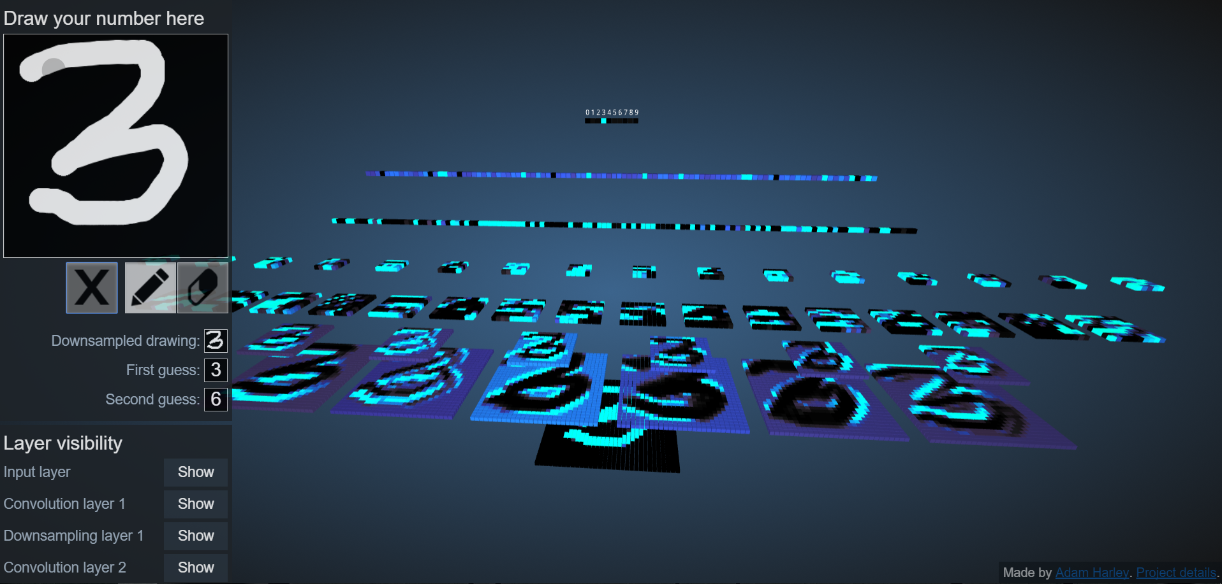
Convolution as a “filter”
http://scs.ryerson.ca/~aharley/vis/conv/
Machine Learning using Tensorflow
Shu-Ting Pi

Slide 10
Exercise
code06_ex1_v1:
  Using TensorFlow to perform CNN
code06_ex1_v2:
  Using TensorFlow to perform CNN
  Using t-SNE to cluster the output of flatten layer
code06_ex2_v2:
  Using Keras to perform CNN
Machine Learning using Tensorflow
Shu-Ting Pi

